Slide 1
Finding Unity & Common Ground: What Ohio
Parents Want for their Children’s Education
A report from Children’s Defense Fund-Ohio based on a statewide survey conducted by
Baldwin Wallace University Community Research Institute (BW CRI) in May 2022

Slide 2
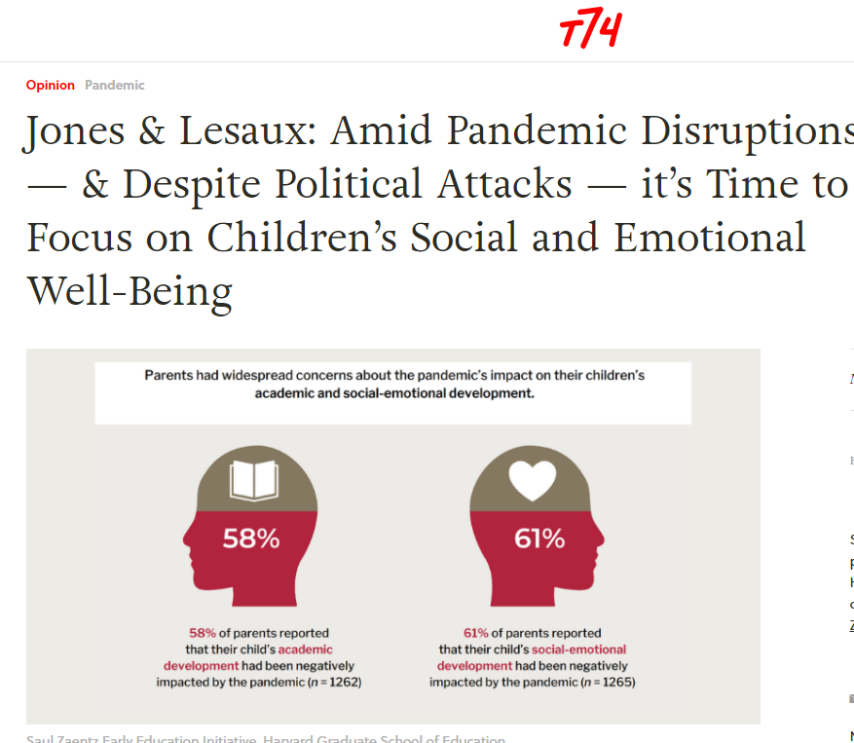
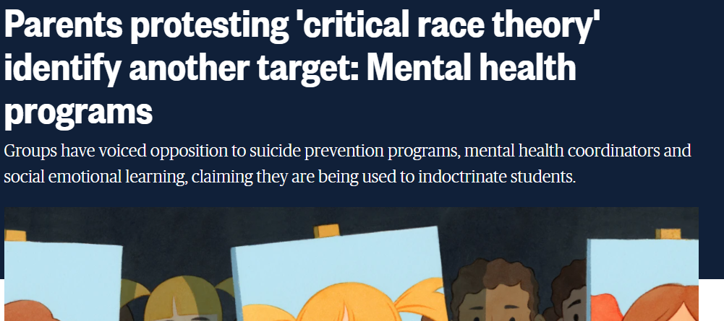
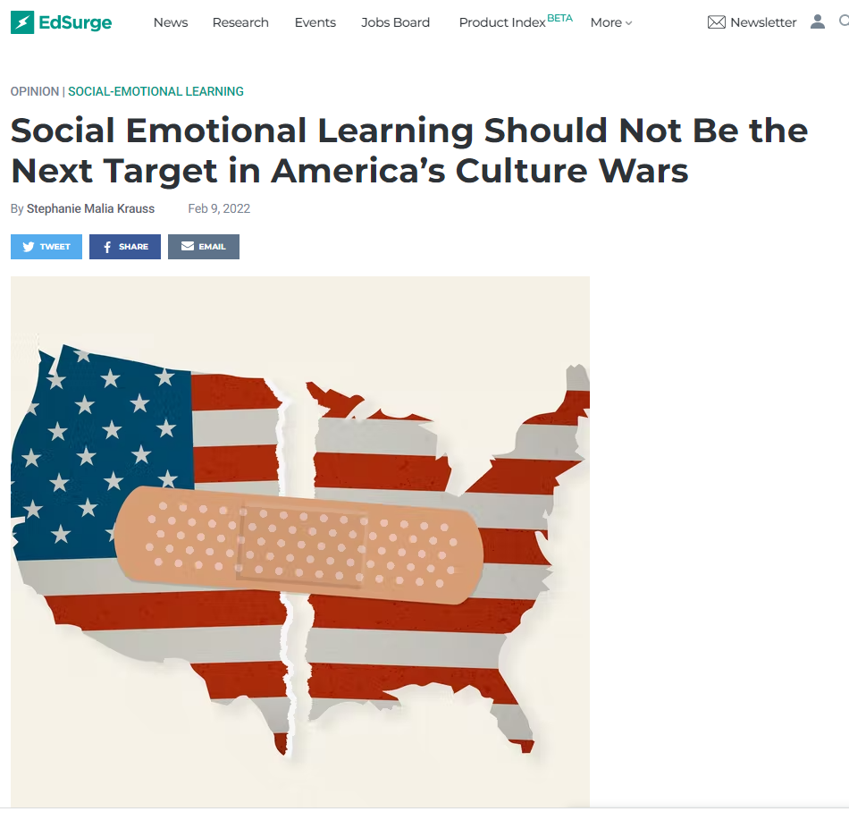
Why Whole Child? Why Ask Parents?
We know that when whole child needs are met – nutrition, social emotional wellbeing, physical and mental health, and basic needs – children experience better educational outcomes.
However, debates in recent years in Ohio and across the country have grown heated and divisive in educational spaces, with vocal groups opposing whole child approaches like Social-Emotional Learning (SEL), school health care, and even equity-driven policies and practices.
But are Ohio parents among those in opposition? As key partners in their children’s educational success, finding out what parents truthfully want for their children’s education is important.

Slide 3
So what do Ohio parents & caregivers truly want for their children’s education?

Slide 4

To find out, a statewide survey was conducted.
PROJECT PURPOSE:
To examine parents’ attitudes towards Ohio’s Whole Child Framework.
SURVEY DESIGN:
CDF-Ohio staff worked with BW CRI researchers to design a survey instrument that accurately gauges the opinions of Ohio parents on SEL and other issues related to whole child approaches and supports.
The survey consisted of 71 questions, including 3 optional open-ended questions, that fell into 9 unique categories, including school nutrition, mental health, life skills, trust in teachers, and SEL, among others.
DATA COLLECTION:
BW CRI partnered with SurveyUSA to interview 1,370 Ohio parents of K-12 students from May 9-28, 2022.

Slide 5
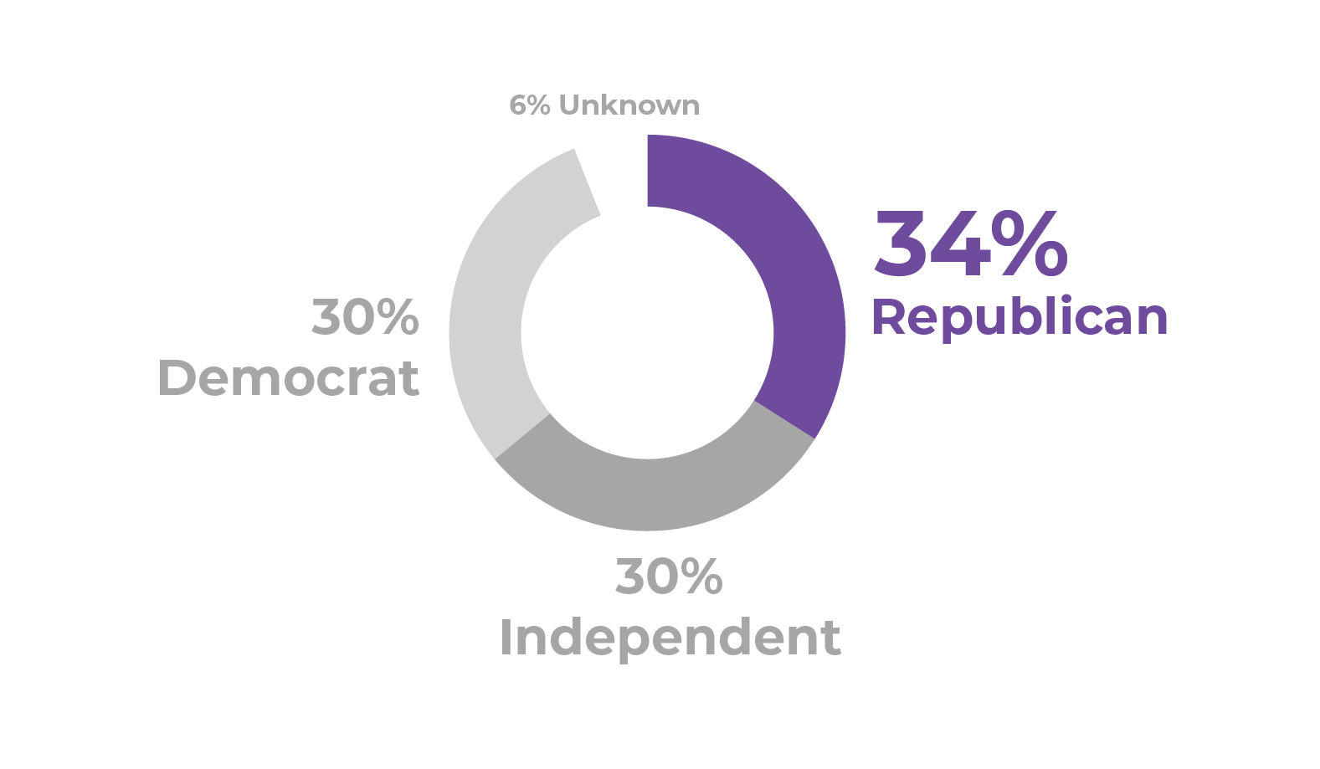

First-of-its-kind Survey of Ohio Parents of
School-Age Children

Slide 6
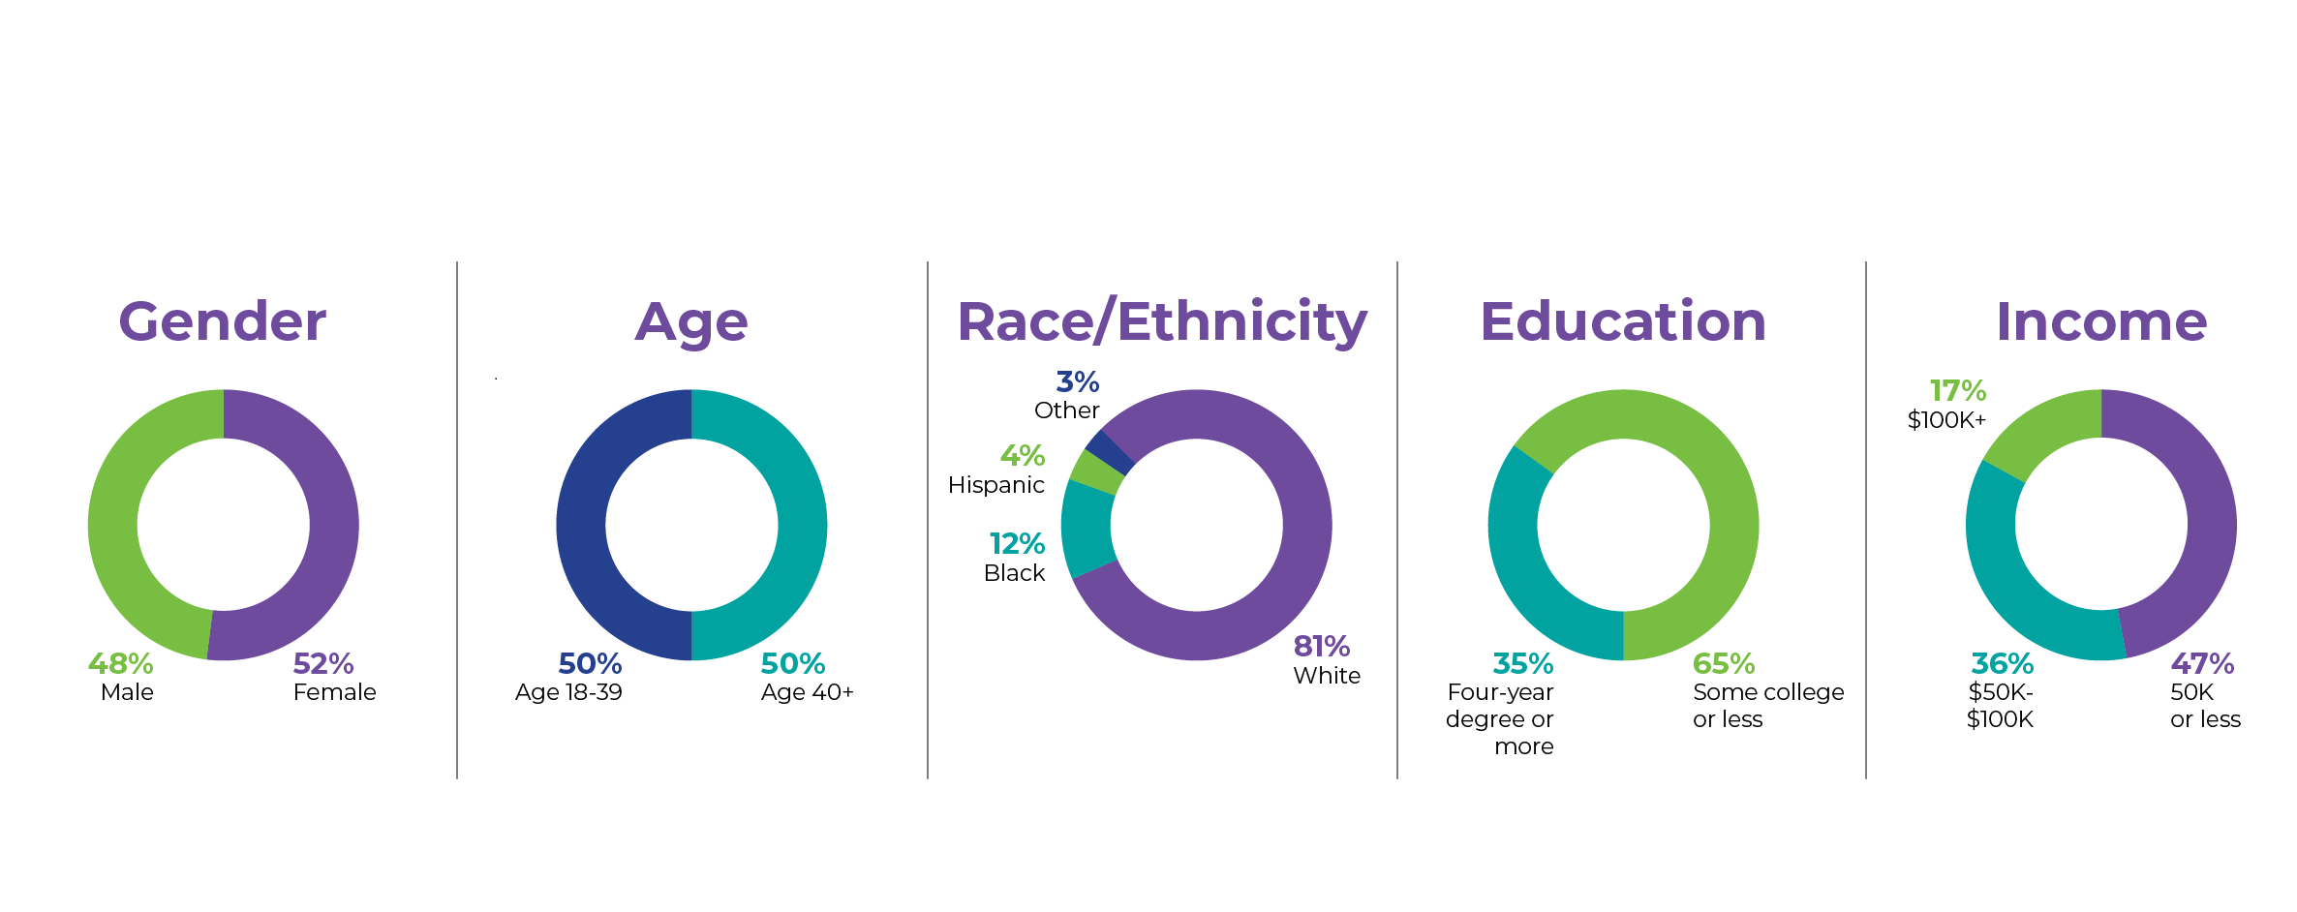
First-of-its-kind Survey of Ohio Parents of
School-Age Children

Slide 7
Key Observations from First-of-its-kind Survey of Ohio Parents of
School-Age Children

Slide 8

School Nutrition
Ohio parents support free school meals for all students – making sure that all children have the nutrition they need to be healthy and learn.

Slide 9
Key Results
School Nutrition
64% of Ohio parents said their child ate a lunch their school provided at no cost at least once in the past week, with a near majority (46%) reporting their child ate a school-provided lunch all five days.
87% agreed that schools should provide school meals at no cost to all students, regardless of the student’s ability to pay.
93% agreed that schools should offer a variety of breakfast and lunch menu options that address a student’s dietary needs (e.g., dietary restrictions, medical, or cultural accommodations).
82% agreed that school meals are helpful to their families.

Slide 10

Mental Health
Ohio parents support mental health priorities in schools and want increased funding to support more on-site, school-based services for students.

Slide 11
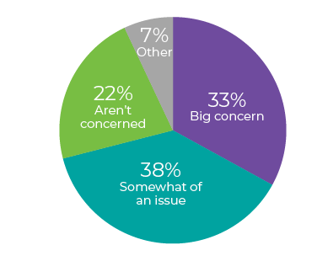
Key Results
Parents Level of Concern about Mental Health
Mental Health
93% agreed that their child’s school should teach students how to live healthy lifestyles (e.g., smoking and drug abuse prevention, etc.). There was broad agreement across subsets.
84% agreed that their child’s school should teach students how to be aware or more aware of their own mental health.
83% agreed that their child feels a sense of belonging in their school.
73% agreed that their child’s school needs more service providers available on-site to provide mental health services.
71% agreed that more funding is needed to provide access to mental health services at their child’s school. There was greater agreement among parents with a bachelor’s degree or more and Democrats.

Slide 12

Whole Child Framework
Ohio parents support the Whole Child Framework and approaches that support the whole child in schools and prioritize equity in education.

Slide 13
Key Results
Beyond the Basics – Whole Child Framework
91% agreed that preparing students for lifelong success is a community-wide effort.
90% agreed that schools should focus beyond academics to also support the health and wellness of students.
90% agreed schools should customize their teaching to accommodate for differences in students’ abilities.
87% agreed that schools should use evidence-based curriculum and instruction to educate students.
85% agreed that schools should use curriculum and instructional materials relevant to the life experiences, cultures, and languages of their students.

Slide 14
Key Results
Equity
93% of parents agreed that our society should do what is necessary to ensure equal opportunity to succeed.
92% of parents agreed that our society should provide more support for some children based on need, so that all children can be successful in life.
90% said it is very important that schools prioritize equity (in a question including a definition of equity in education).

Slide 15

Parents as Partners
Ohio parents trust their child’s classroom teachers to teach age-appropriate content and be good role models.

Slide 16
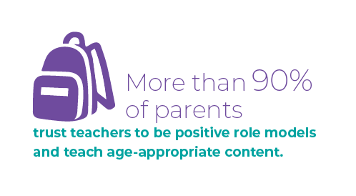
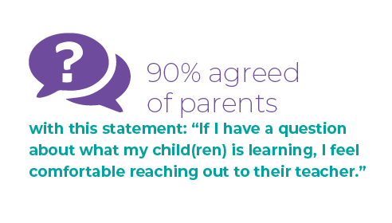
Key Results
Trust in Teachers

Slide 17

Social Emotional Learning (SEL)
Ohio parents support the teaching of Social-Emotional Learning (SEL) in schools to set their children up for future success.

Slide 18
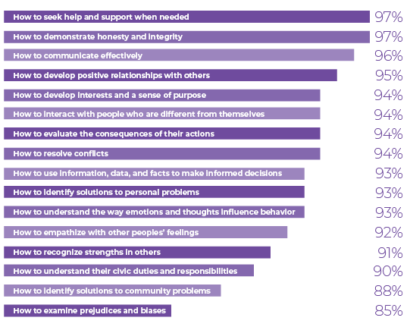
Key Results
Must-Have Skills
to Teach
Parents were asked about these specific life skills without the term “Social-Emotional Learning (SEL)” used in the question to avoid politicization and bias in the data.

Slide 19
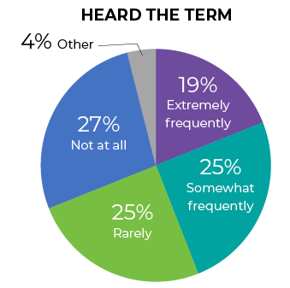
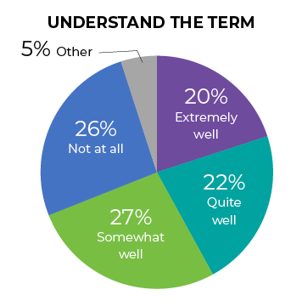
Key Results
Social Emotional Learning (SEL) in Schools
68% supported schools teaching their children SEL skills.
86% said it is important that Ohio’s voluntary state standards for social-emotional learning be available as a resource to school districts.
87% of parents agreed that schools should provide age-appropriate sexual abuse prevention education (e.g. “good touch/bad touch,” consent, dating violence, unhealthy relationships, etc.) to help students recognize signs of abuse.

Slide 20



What Parents & Caregivers are Saying…

Slide 21
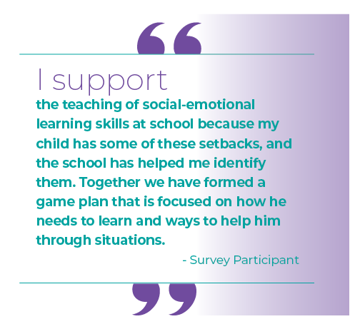
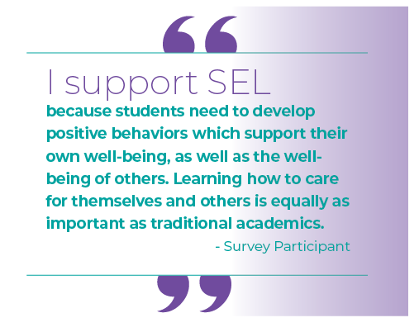

What Parents & Caregivers are Saying…

Slide 22
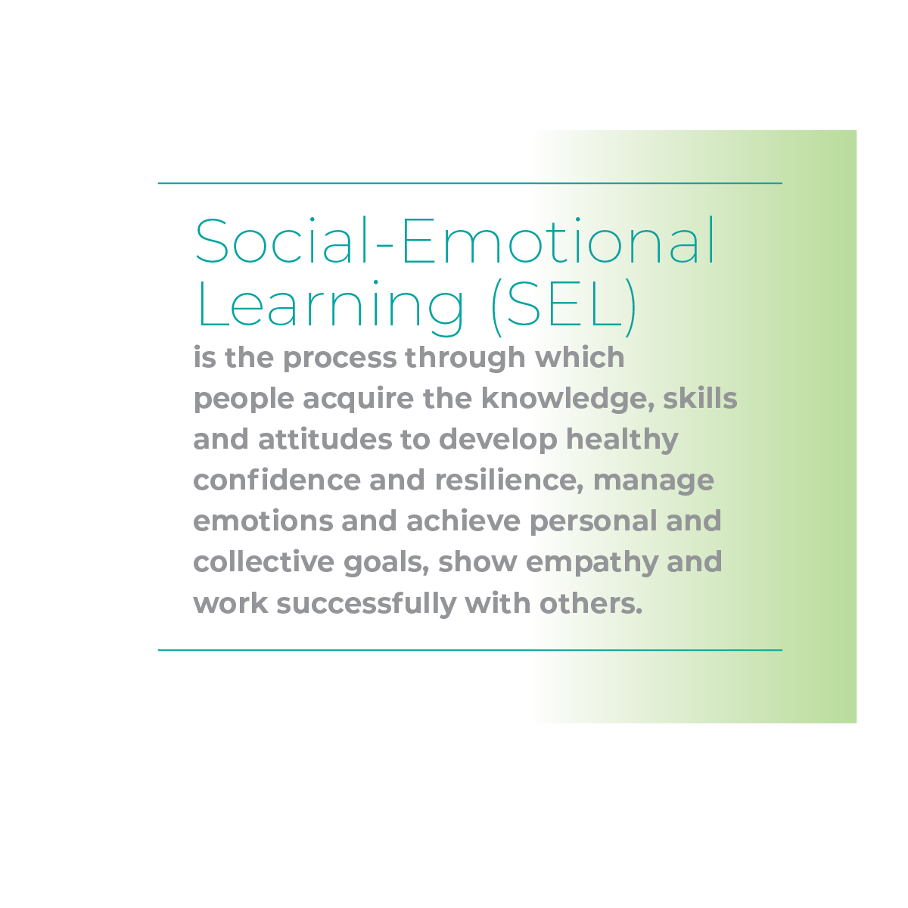
Recommendations
1.
Be as explicit as possible when using the term Social-Emotional Learning (SEL) to raise awareness of the meaning and the accompanying benefits for children. Always refer to the concrete skills that make up SEL to avoid misunderstanding of jargon: Self-Awareness, Self-Management, Social Awareness, Relationship Skill, & Responsible Decision-Making.

Slide 23

Recommendations
2.
Prioritize whole child well-being in education with strong district, school, family, and community partnerships to support students’ basic needs, learning opportunities, and overall well-being. Ensuring student success is a community-wide effort.

Slide 24
Recommendations
3.
Protect Ohio’s Voluntary K-12 Social and Emotional Learning Standards. These standards were a response to programming already happening in Ohio schools and were developed over a 10-month period in a transparent stakeholder process to help each district consider their own local implementation, based on community needs and values. Nearly 90% of Ohio parents agree it is important that Ohio’s voluntary state standards for social-emotional learning be available as a resource to school districts.

